Slide 1
Angular 2
Introduction
By Monirul Molla

Slide 2
What is Angular?
Angular is a JavaScript Framework which allow you to create a single page application (SPA’s)
Angular 1 vs Angular 2 vs Angular 4
Angular 1=AngularJs is very popular js framework, released a couple of years ago.
Angular 2= Angular the complete rewrite of Angular 1 and now it’s the future of angular.
Angular 3= This version release was skipped due to version conflicts.
Angular 4= Its simply an update of angular 2
NodeJs –Latest Version-It will build the project and create a server to publish and run the application.
Angular CLI (Command Line Interface): npm install @angular/cli [npm-node package manager]
TypeScript

Slide 3
What is TypeScript?
TypeScript is a super set of java script, TypeScript compile to java script instantly and it will be taken care by the browser itself.

Slide 4
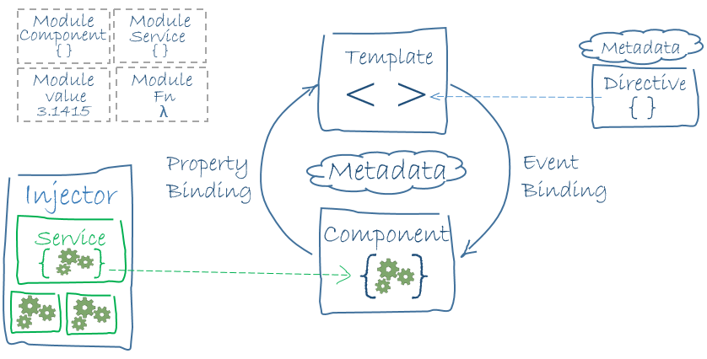
Angular 2-Achtectural Overview
Module
Component
Template
Metadata
Data Binding
Directive
Service
Dependency Injection
Component/Template Duality: model-view-controller (MVC) or model-view-view-model (MVVM).
In Angular, the component plays the part of the controller/model, and the template represents the view
https://angular.io/docs/ts/latest/guide/template-syntax.html

Slide 5
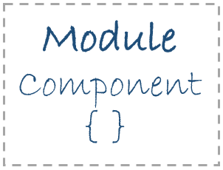
Modules
import { NgModule } from '@angular/core';
import { BrowserModule } from '@angular/platform-browser';
@NgModule({
imports: [ BrowserModule ],
providers: [HeroService ],
declarations: [ AppComponent ],
exports: [ AppComponent ],
bootstrap: [AppComponent ]
})
export class AppModule { }

Slide 6
src/main.ts
import { platformBrowserDynamic } from '@angular/platform-browser-dynamic';
import { AppModule } from './app/app.module';
platformBrowserDynamic().bootstrapModule(AppModule);

Slide 7
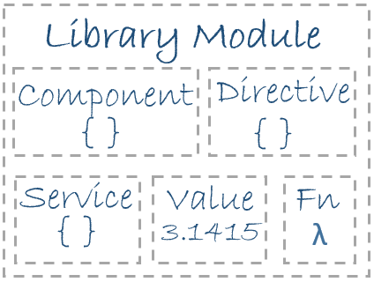
Library modules
import {Component} from 'angular2/core';
import { BrowserModule } from '@angular/platform-browser';
Angular apps are composed of modules.
Modules export things — classes, function, values — that other modules import.
We prefer to write our application as a collection of modules, each module exporting one thing.

Slide 8
Component
app/heroes.component.ts
import { Component, OnInit } from '@angular/core';
@Component({ selector: 'my-heroes', templateUrl: './heroes.component.html', styleUrls: ['./heroes.component.css'] })
export class HeroesComponent implements OnInit {
constructor(private heroService : HeroService){ }
heroes: Hero[];
selectedHero: Hero;
ngOnInit(){
this.heroes = this.heroService.getHeroes();
}
selectHero(hero: Hero) { this.selectedHero = hero; }
}

Slide 9
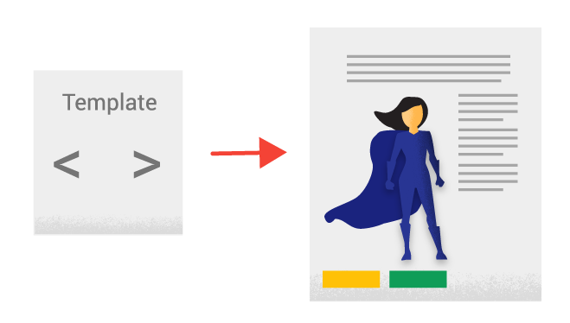
Template
app/heroes.component.html
<ul class="heroes"> <li *ngFor="let hero of heroes" (click)="onSelect(hero)"> <span class="hero-element"> <span class="badge">{{hero.id}}</span> {{hero.name}} </span> <button class="delete-button"
(click)="deleteHero(hero, $event)">Delete</button> </li> </ul>
<div *ngIf="selectedHero"> <h2> {{selectedHero.name | uppercase}} is my hero </h2> <button (click)="gotoDetail()">View Details</button> </div>

Slide 10
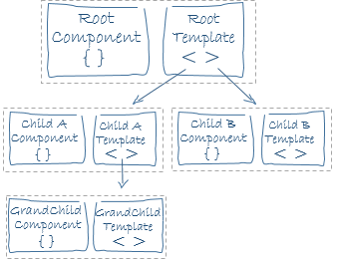
Template-(Child Template)
app/heroes.component.html
<button (click)="addHero()">Add New Hero</button> <div *ngIf="addingHero"> <my-hero-detail (close)="close($event)"></my-hero-detail> </div>

Slide 11

Metadata
@Component({ selector: 'my-heroes', templateUrl: './heroes.component.html', styleUrls: ['./heroes.component.css'],
directives: [HeroDetailComponent],
providers: [HeroService
})
export class HeroesComponent implements OnInit {}
selector - A selector that tells Angular to create and insert an instance of this component where it finds a <my-heroes> tag in parent HTML: < my-heroes ></ my-heroes >
Angular inserts an instance of the HeroesComponent view between tags.
templateUrl - the address of this component's template
styleUrls- address of the css file
directives - an array of the Components or Directives this template requires
providers - an array of dependency injection providers for services that the component requires

Slide 12
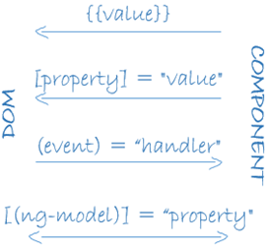
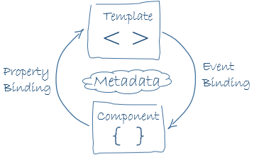
Data Binding
app/heroes.component.html
Value:: <span class="badge">{{hero.id}}</span> {{hero.name}}
Property:<table [class.hidden]="!showNgFor">
Event::<button class="delete-button" (click)="deleteHero(hero, $event)">Delete</button>
app/hero-detail.component.html
Two Way:<input [(ngModel)]="hero.name" placeholder="name" />

Slide 13

Directives
app/heroes.component.html
<li *ngFor="let hero of heroes" (click)="onSelect(hero)”>
<div *ngIf="addingHero">
app/hero-detail.component.html
<input [(ngModel)]="hero.name" placeholder="name" />
*ngFor tells Angular to stamp out one <li> per hero in the heroes list.
*ngIf includes the HeroDetail component only if addingHero is true.
ngModel directive, which implements two-way data binding.
Some more example of directives are ngSwitch, ngClass, ngStyle etc.

Slide 14

Services
import { Injectable } from '@angular/core'; import { Headers, Http, Response } from '@angular/http'; import 'rxjs/add/operator/toPromise'; import { Hero } from './hero'; @Injectable() export class HeroService { private heroesUrl = 'app/heroes'; // URL to web api constructor(private http: Http) { } getHeroes(): Promise<Array<Hero>> { return this.http .get(this.heroesUrl) .toPromise() .then((response) => { return response.json().data as Hero[]; }) .catch(this.handleError); } private handleError(error: any): Promise<any> { console.error('An error occurred', error); return Promise.reject(error.message || error); } }
There is nothing specifically Angular about services. Angular has no definition of a service. There is no service base class, and no place to register a service.
Here's a HeroService that uses a Promise to fetch heroes.

Slide 15
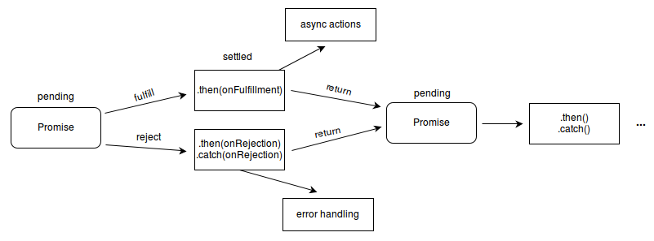
Services-Promise

Slide 16
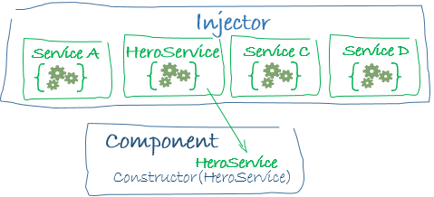
Dependency injection
app/hero.service.ts
@Injectable() export class HeroService {
app/heroes.component.ts
constructor( private heroService: HeroService) { }
Alternate:::app/heroes.component.ts
app/app.module.ts
@Component({ selector: 'hero-list',
templateUrl: './hero-list.component.html',
providers: [ HeroService ] })
providers: [HeroService],
(we get a new instance of the service with each new instance of that component)

Slide 17
Execution Step Configuration
app.component.ts
@Component({ selector: 'my-root',
app.module.ts===➔
import {bootstrap} from 'angular2/platform/browser' import {AppComponent} from './app.component' bootstrap(AppComponent);
main.ts
import { platformBrowserDynamic } from '@angular/platform-browser-dynamic';
import { AppModule } from './app/app.module';
platformBrowserDynamic().bootstrapModule(AppModule);
index.html
<my-root>Loading...</my-root>
angula-cli.json
"index": "index.html", "main": "main.ts",
package.json
name, version
dependencies (SystemJS is used as module system)
devDependencies
tsconfig.json
TypeScript configuration npm start

Slide 18
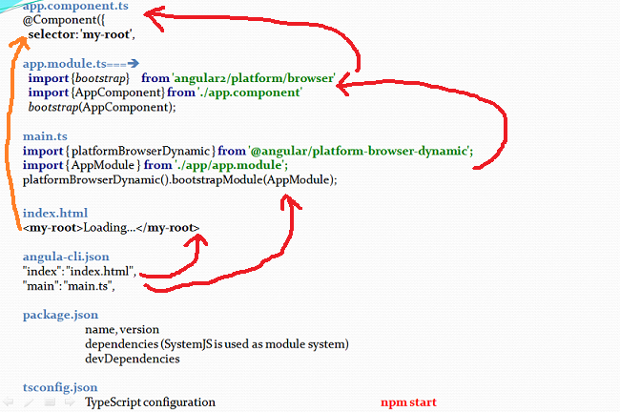
Excecution Step

Slide 19
Routing
The Angular Router enables navigation from one view to the next as users perform application tasks
<base href>
index.html
<base href="/">
Router imports
app-routing.module.ts
import { RouterModule, Routes } from '@angular/router';
Configuration
app-routing.module.ts
const routes: Routes = [ { path: '', redirectTo: '/dashboard', pathMatch: 'full' }, { path: 'dashboard', component: DashboardComponent },]; @NgModule({ imports: [RouterModule.forRoot(routes)], exports: [RouterModule] })

Slide 20
Routing Continue
The Angular Router enables navigation from one view to the next as users perform application tasks
Router outlet
app.component.ts
<router-outlet></router-outlet>
Configuration
app.component.ts
<nav> <a routerLink="/dashboard" routerLinkActive="active">Dashboard</a> <a routerLink="/heroes" routerLinkActive="active">Heroes</a> </nav> <router-outlet></router-outlet>
Configuration
app.module.ts
@NgModule({ imports: [ AppRoutingModule,

Slide 21
Obserables

Slide 22
Forms
<input type="text" class="form-control" id="name" required [(ngModel)]="model.name" name="name" #spy>
<br>TODO: remove this: {{spy.className}}

Slide 23
Pipe
Pipes transform displayed values within a template.
app/heroes.component.html
<div *ngIf="selectedHero"> <h2> {{selectedHero.name | uppercase}} is my hero </h2> <button (click)="gotoDetail()">View Details</button> </div>
Built-in pipes
DatePipe, UpperCasePipe, LowerCasePipe, CurrencyPipe, and PercentPipe
Chaining pipes
The chained hero's birthday is {{ birthday | date | uppercase}}

Slide 24
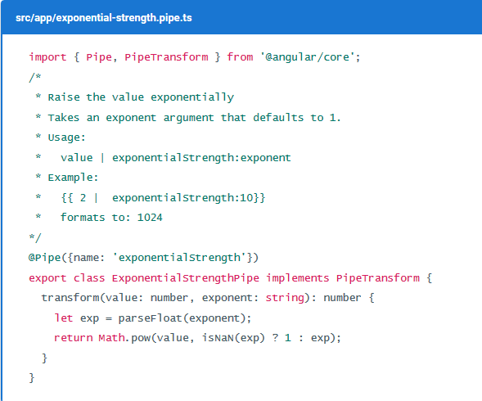
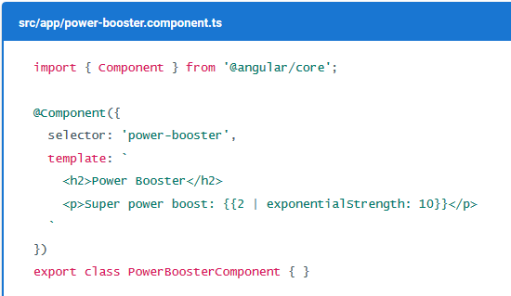
Pipe Custom

Slide 25
HTTP
HTTP is the primary protocol for browser/server communication.
The Angular HTTP library simplifies application programming with the XHR and JSONP APIs.
Angular Http client service is injected into the HeroService constructor
import { Injectable } from '@angular/core'; import { Headers, Http, Response } from '@angular/http'; import 'rxjs/add/operator/toPromise'; import { Hero } from './hero'; @Injectable() export class HeroService { private heroesUrl = 'app/heroes'; // URL to web api constructor(private http: Http) { } getHeroes(): Promise<Array<Hero>> { return this.http .get(this.heroesUrl) .toPromise() .then((response) => { return response.json().data as Hero[]; }) .catch(this.handleError); }

Slide 26
Authentication

Slide 27
Deployment

